Slide 1
Input and Output in Java

Slide 2
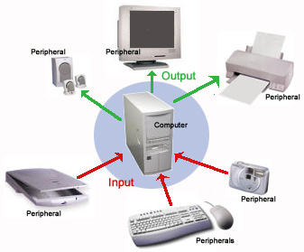
What is I/O?
Communication between the computer and the outside world

Slide 3


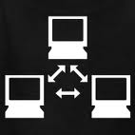
What’s in the Outside World?
Human users
Hardware devices
Monitors, keyboards, disk drives …
Other computers and programs

Slide 4
What are the Different Types of I/O?
Console I/O
Keyboard I/O
File I/O
Network I/O
…and possibly more

Slide 5

How Does Java Support I/O?
The Java I/O API
The java.io package
Since JDK 1.0
Extensible

Slide 6
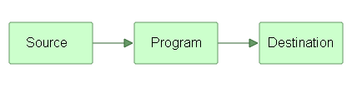
Introduction
Input and Output (I/O) is used to process the input and produce the output based on the input.
Java uses the concept of stream to make I/O operations fast.
java.io package contains all the classes required for input and output operations.
Source is that from where data is read and the destination is that one to where data is written.
The source and destination need not be a file only; it can be a socket or keyboard input etc.

Slide 7

Stream

Slide 8
What is a Stream in Java
java.lang package defines a class called System, which encapsulates several aspects of the run-time environment.
Using some of its methods, you can do the settings of various properties associated with the system.
System also contains three predefined stream variables, in, out, and err.
These fields are declared as public and static within System.
They can be used by any other part of the program and without reference to a specific System object.
A stream represents a flow of data, or a channel of communication with (at least conceptually) a writer at one end and a reader at the other.
NOTE : Java programs perform I/O through streams. A stream is an abstraction that either produces or consumes information.

Slide 9
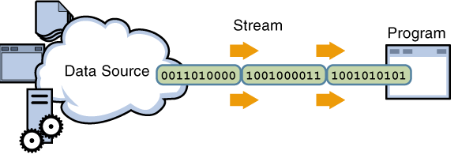
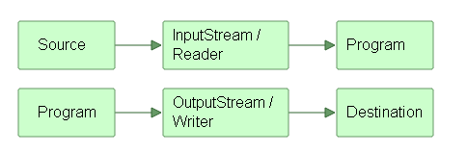
Three streams are created for us automatically:
1) System. out : standard output stream
2) System. in : standard input stream
3) System.err: standard error
To do the job of reading and writing, there comes two types of streams – input streams and output streams.

Slide 10
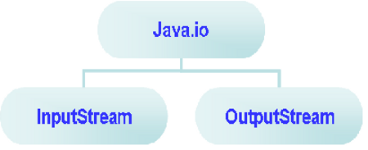
Types of Streams
In java.io package there are two abstract classes
InputStream (abstract class)
OutputStream for Stream Classes(abstract class)

Slide 11
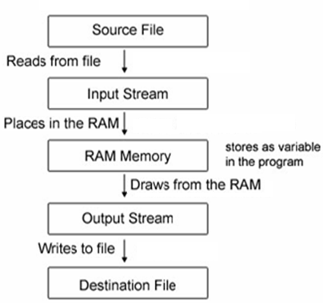
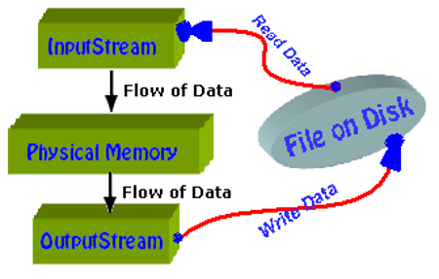
I/O Streams Concept

Slide 12
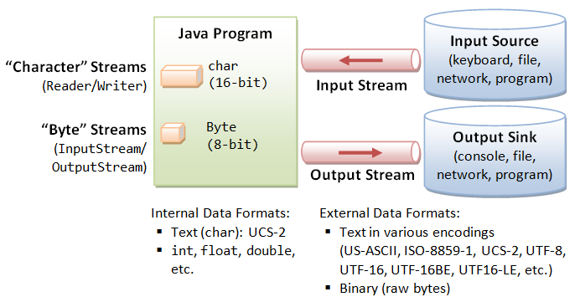
Classification of IO Streams
Both Input and Output Streams are classified as
1) Byte streams
2) Character streams.

Slide 13
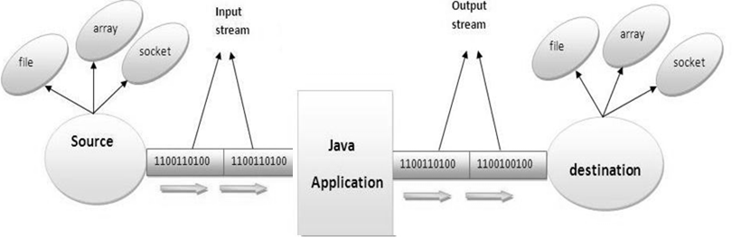
IO streams
InputStream : Java application uses an input stream to read data from a source, it may be a file , an array, peripheral device or socket.
OutputStream : Java application uses an output stream to write data to a destination, it may be a file , an array, peripheral device or socket.

Slide 14
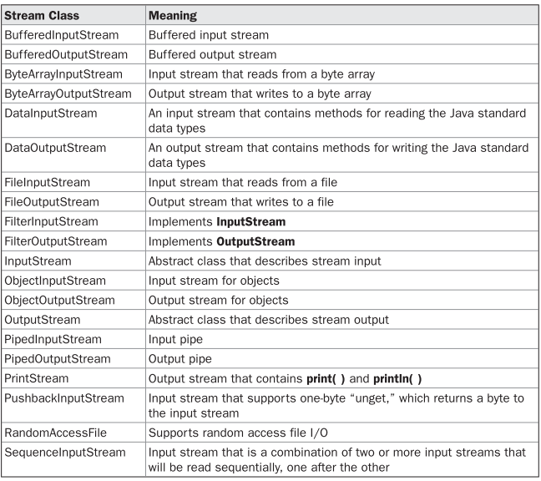
Table : Byte Stream I/O Classes

Slide 15
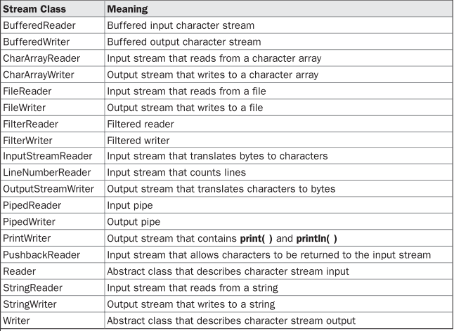
The Character Stream I/O Classes

Slide 16
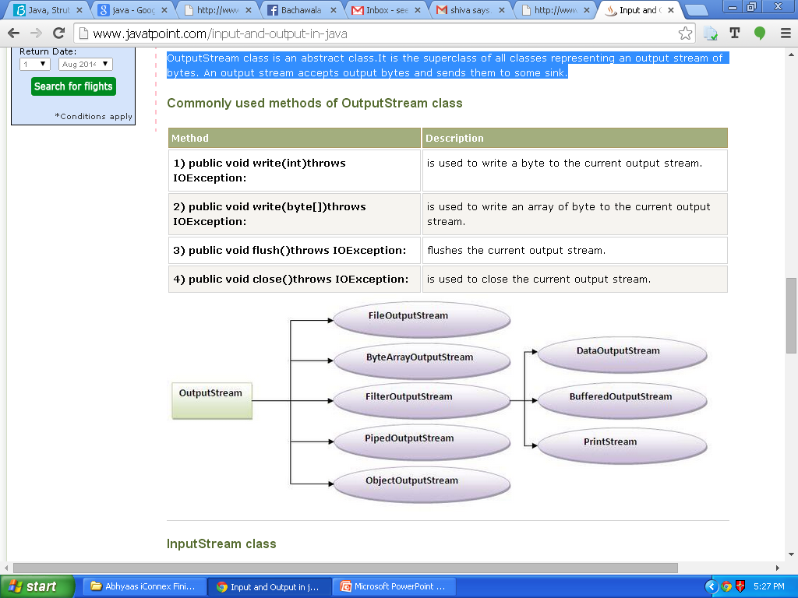

Methods

Slide 17
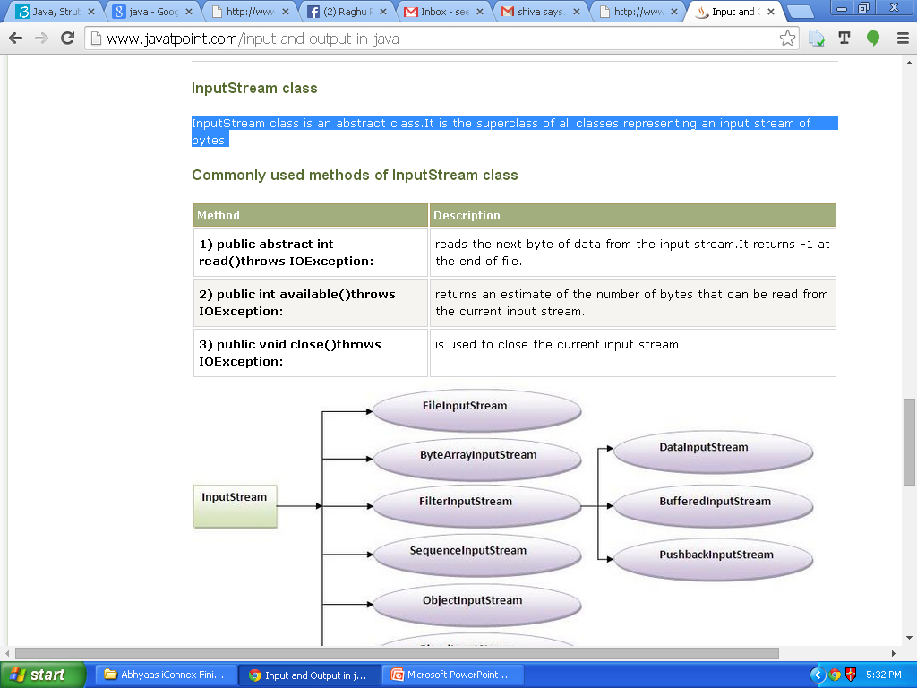
commonly used InputStream Methods

Slide 18
File
The File class does not operate on stream
It deals directly with files and the file system.
File class does not specify how information is retrieved from or stored in files; it describes the properties of a file itself.
A File object manipulates the information associated with a disk filelike the file permissions, time, date, and directory path, and helps to navigate subdirectory hierarchies.
A directory in Java is also treated as a File with one additional property—a list of filenames that can be examined by the list( ) method.
The following constructors can be used to create File objects:
File(String directoryPath)
File(String directoryPath, String filename)
File(File dirObj, String filename)
File(URI uriObj)

Slide 19
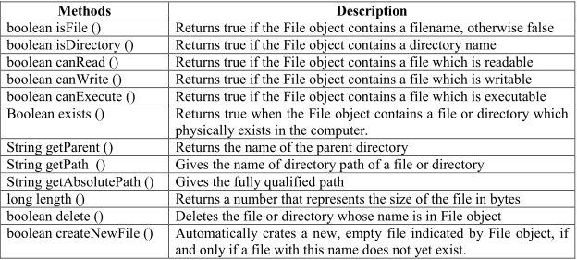

Slide 20
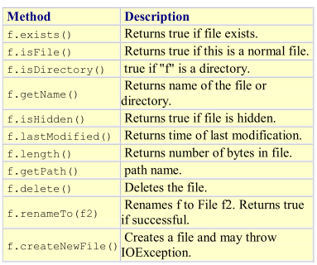

Slide 21
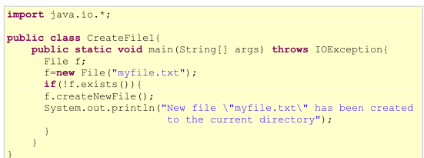
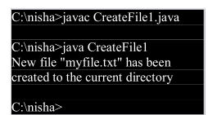
Ex: creating a new File

Slide 22
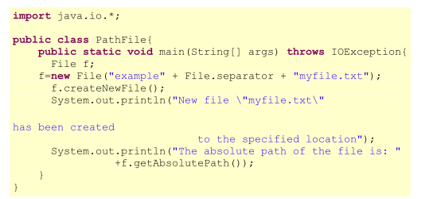
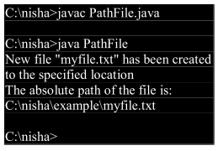

Constructing a File Name path

Slide 23




Reading Console Input
In Java, console input is accomplished by reading from System.in.
It refers to an object of type InputStream, it can be used for inputStream.
Reading Characters :
Reading Strings:
Writing Console Output

Slide 24
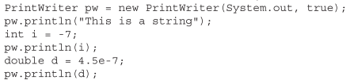
PrintWriter Class
It is one of the character-based classes.
PrintWriter supports the print( ) and println( ) methods for all types including Object.

Slide 25
Reading and Writing Files
Two of the most often-used stream classes are FileInputStream and FileOutputStream, which create byte streams linked to files.
To open a file, we simply create an object of one of these classes, specifying the name of the file as an argument to the constructor.
When you create an input stream, if the file does not exist, then FileNotFoundException is thrown.
When you are done with a file, you should close it by calling close( ).
To read from a file, you can use a version of read( ) that is defined within FileInputStream , it reads a single byte from the file and returns the byte as an integer value.
read( ) returns –1 when the end of the file is encountered.

Slide 26
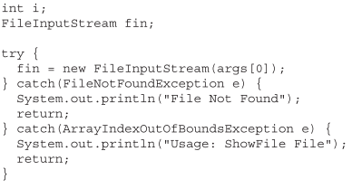
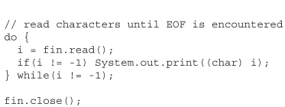
Ex:
Code Snippet using read( ) to input and display the contents of a text file,

Slide 27

To write to a file, you can use the write( ) method defined by FileOutputStream.
Note : If an error occurs during writing, an IOException is thrown.

Slide 28


File
File class does not operate on streams, It deals directly with files and the file system.
File class describes the properties of a file itself such as file permissions, time, date, and directory path, and to navigate subdirectory hierarchies.
To create 3 files
Most of the File methods are self-explanatory.
File also includes two useful utility methods

Slide 29
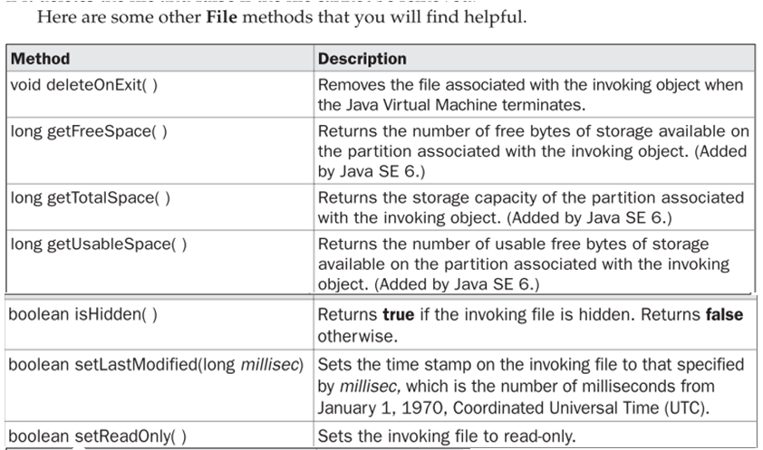
File class Methods

Slide 30

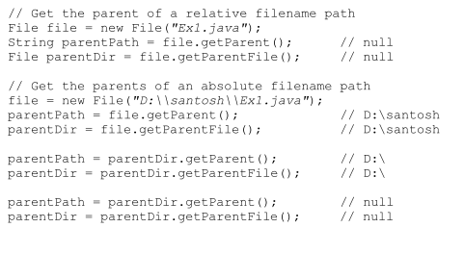
Directories
A directory is a File that contains a list of other files and directories.
When you create a File object and it is a directory, the isDirectory( ) method will return true.
we can use list( ) using a file object to extract the list of other files and directories inside.

Slide 31
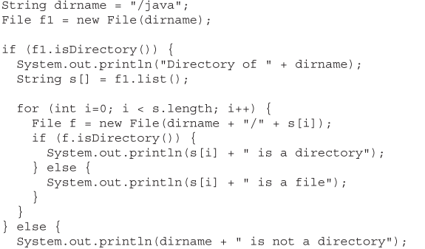
//using Directories

Slide 32
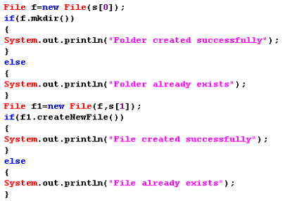
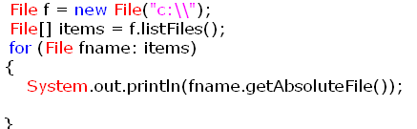
Ex:

Slide 33

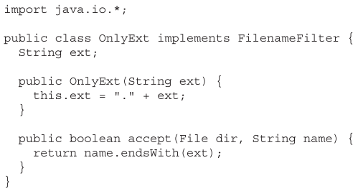
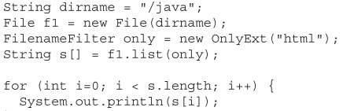
FilenameFilter
To limit the number of files returned by the list( ) method to include only those files that match a certain filename pattern, or filter. We use a second form of list( )
FilenameFilter defines only a single method, accept( ), which is called once for each file in a list.

Slide 34
Java Stream Classes
Java’s stream-based I/O is built upon four abstract classes
InputStream
OutputStream,
Reader
Writer
InputStream and OutputStream are designed for byte streams.
Reader and Writer are designed for character streams.
you should use the character stream classes when working with characters or strings,
use the byte stream classes when working with bytes or other binary objects (images , sounds , video files etc).

Slide 35
Byte Streams
For handling byte-oriented I/O
A) InputStream
abstract class
It implements Closeable interface.
IOException will be thrown by most of its methods
It has the following frequently used methods( read(),skip(), mark() and reset() , close())
B) OutputStream
abstract class
It implements Closeable and Flushable interfaces.
Most of the methods in this class return void and throw an IOException
It has the following frequently used methods (write(),flush(),close() )

Slide 36
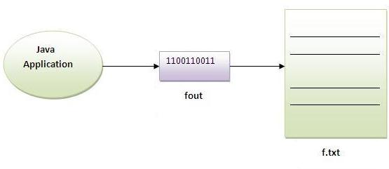
File Handling
FileInputStream and FileOutputStream classes are used to read and write data in file. In another words, they are used for file handling in java.
FileOutputStream class :
A FileOutputStream is an output stream for writing data to a file.
If we want to write primitive values then use FileOutputStream. Instead, for character-oriented data, prefer FileWriter.
But we can write byte-oriented as well as character-oriented data.

Slide 37
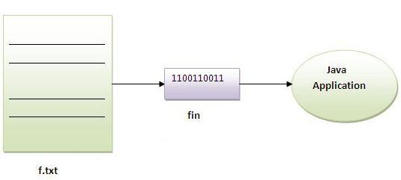
FileInputStream class
A FileInputStream obtains input bytes from a file.It is used for reading streams of raw bytes such as image data.
For reading streams of characters, consider using FileReader.
It should be used to read byte-oriented data.For example, to read image etc.

Slide 38


ByteArrayInputStream
ByteArrayInputStream is an implementation of an input stream that uses a byte array asthe source. This class has two constructors, each of which requires a byte array to provide the data source.

Slide 39
ByteArrayOutputStream
In this stream, the data is written into a byte array. The buffer automatically grows as data is written to it.
Closing a ByteArrayOutputStream has no effect.
Constructor:
1) ByteArrayOutputStream():creates a new byte array output stream with the initial capacity of 32 bytes, though its size increases if necessary.
2) ByteArrayOutputStream(int size):creates a new byte array output stream, with a buffer capacity of the specified size, in bytes.
Methods:
1) public synchronized void writeTo(OutputStream out) throws IOException: writes the complete contents of this byte array output stream to the specified output stream.

Slide 40
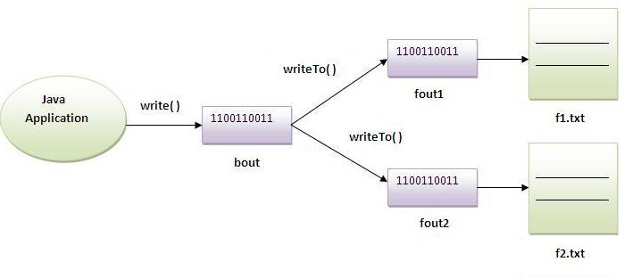

Slide 41
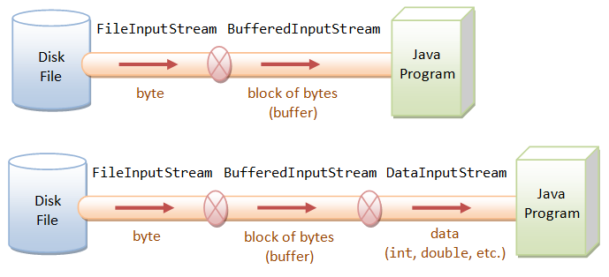
BufferedInputStream
The Java.io.BufferedInputStream class adds functionality to another input stream, the ability to buffer the input and to support the mark and reset methods.
Following is the declaration for Java.io.BufferedInputStream class:
public class BufferedInputStream extends FilterInputStream

Slide 42
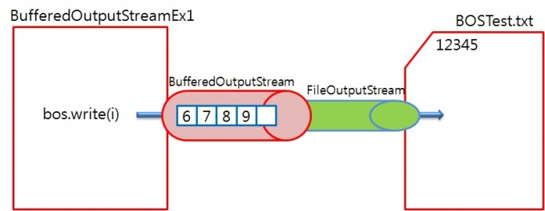
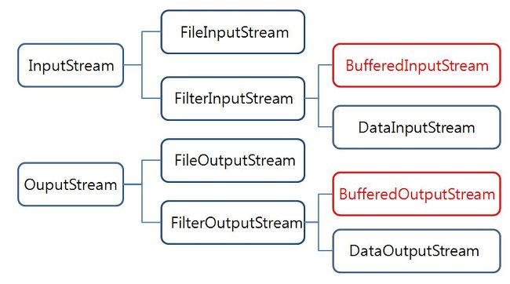
BufferedOutputStream class:
BufferedOutputStream used an internal buffer. It adds more efficiency than to write data directly into a stream. So, it makes the performance fast.

Slide 43
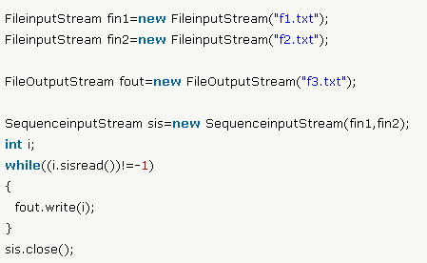
SequenceInputStream
SequenceInputStream class is used to read data from multiple streams.
Ex:

Slide 44

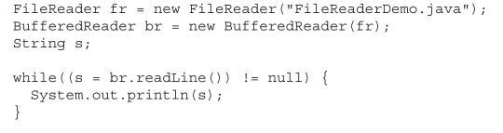
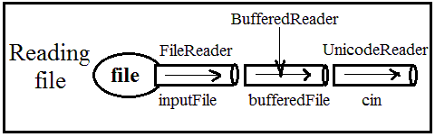
FileReader class:
FileReader class is used to read data from the file.
Most commonly used constructors.
Ex:

Slide 45
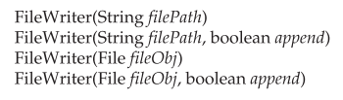
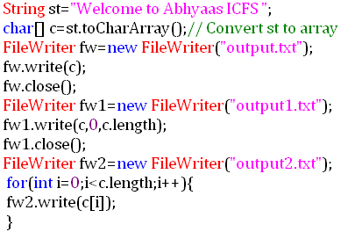
FileWriter class:
FileWriter class is used to write character-oriented data to the file.
It has the following constructors
Ex:
Sun Microsystem has suggested not to use the FileInputStream and FileOutputStream classes if you have to read and write the textual information.

Slide 46

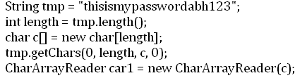
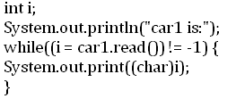

CharArrayReader
CharArrayReader is an implementation of an input stream that uses a character array as the source.
This class has two constructors, each of which requires a character array to provide the data source:
Ex:

Slide 47
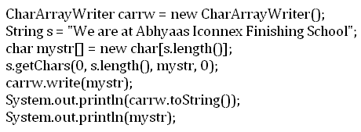
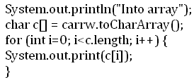
CharArrayWriter
The CharArrayWriter class can be used to write data to multiple files. This class implements the Appendable interface. Its buffer automatically grows when data is written in this stream. Calling the close() method on this object has no effect.
Following is the declaration for Java.io.CharArrayWriter class:
public class CharArrayWriter extends Writer
Ex:

Slide 48
java.io.PrintStream class
The PrintStream class provides methods to write data to another stream. The PrintStream class automatically flushes the data so there is no need to call flush() method. Moreover, its methods don't throw IOException.
import java.io.*;
class PrintStreamTest{
public static void main(String args[])throws Exception{
FileOutputStream fout=new FileOutputStream("mfile.txt");
PrintStream pout=new PrintStream(fout);
pout.println(1900);
pout.println("Hello Java");
pout.println("Welcome to Java");
pout.close();
fout.close(); }
}

Slide 49
Serialization of objects
Serialization is the process of storing object contents into a file.
The class whose objects are stored in the file should implement "Serializable' interface of java.io package.
Serializable interface is an empty interface without any members and methods, such an interface is called 'marking interface' or 'tagging interface'.
'Serializable' interface marks the class objects as 'serializable' so that they can be written into a file.
If serializable interface is not implemented by the class, then writing that class objects into a file will lead to NotSerializableException.
static and transient variables cannot be serialized.
De-serialization is the process of reading back the objects from a file.

Slide 50
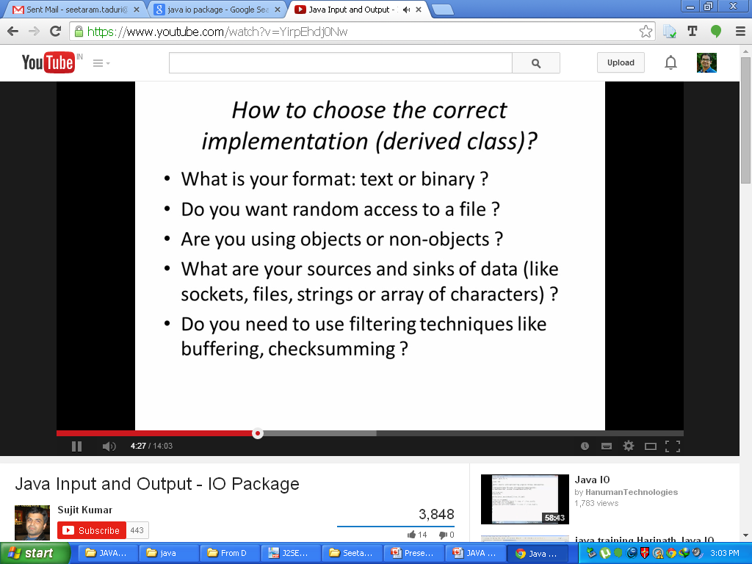
Which class from io package to use ?

Slide 51
Any ?’s

